Slide 1







“ A Walk thru the Program Manual” Kairos Outside…
© 2020 by Kairos Prison Ministry International, Inc. All rights reserved.
This publication, owned by Kairos Prison Ministry International, ® Inc. and licensed only for use by authorized Kairos Outside® programs and their volunteers, may be used only for conducting the authorized Kairos program, and must be used in conjunction with training as authorized and conducted by Kairos. This publication, or any part thereof, may not be reproduced or transmitted in any form or by any means, electronic or mechanical, including photocopying, recording, storage in an information retrieval system, or otherwise, without the prior written permission of Kairos Prison Ministry International, ® Inc.
Kairos® is the registered trademark and servicemark of Kairos Prison Ministry International, Inc. Kairos Outside is a trademark of Kairos Prison Ministry International, Inc.

Slide 2
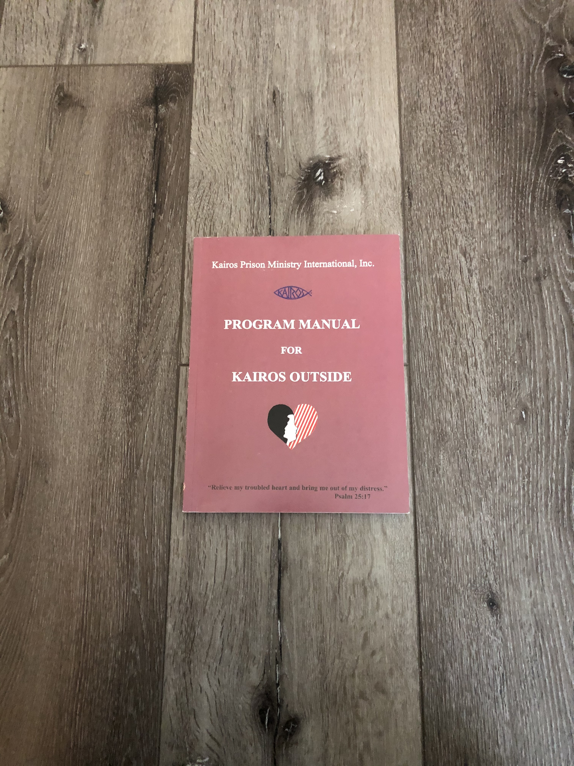
Why We Use the Program Manual
One of our best resources
Underutilized
Contains answers to most questions
Helps volunteers and teams understand the purpose and processes of doing weekends
Explains the purpose for and how to conduct Continuing Ministry
Every volunteer should have a copy and read it
®

Slide 3
Governing Reference Book
First six sections of the manual introduce us to the foundations on which Kairos Prison Ministry and the Kairos Outside Program are based
Provides us with an in-depth understanding of Kairos Prison Ministry International
Teaches us how to merge our ministry with the mission of Kairos
Contains the following:
Vision, Mission, Kairos Statement of Faith, & Core Values Pages 1-2
Policy Statement on Interdenominational Christian Ministry Page 3
Kairos Outside Commitment Statement Page 4
The Kairos Outside Riverbanks Pages 6-15
The Kairos Outside Foundations Pages 16-19
Kairos Outside Negotiable/Non-Negotiable List Pages 20-22
“Who is community” Page 40

Slide 4

Governing Reference
Book
How to use the Program Manual Page 24
The history of Kairos Outside Page 26
The symbols of the Ministry Pages 31-33
An explanation of the Kairos Outside logo Page 34
The Kairos Outside Purpose, Goals, and Philosophy Pages 35-37
An overview of merging the Mission of Kairos with ministry Pages 39-40
Who may attend a Kairos Outside Weekend Page 39-40

Slide 5

Break your group into two teams and ask each team to find the list below in the first six sections of the Program Manual.
Once they find each topic, have them write down what is said about the topic and note the page #s.
The first team to get all 5 wins bragging rights
Have the winning team share their answers.
Give everyone 15 minutes to do this exercise.!
Definition of Ministry
Characteristics of Kairos Outside
Information on Kairos Prison Ministry International’s Annual Conference
Suggestions for the Presentation of the Kairos Outside Foundations
Resources and training opportunities from Kairos Prison

Slide 6

Guide Book for the Teaming Process
The Preparation section of the manual contains everything needed to lead a Kairos Outside Weekend
Important things to know about Kairos Outside Page 41
Leader criteria, selection procedures, and responsibilities Pages 42-45
Team selection process, size and positions Pages 50, 51-54,131
Volunteer qualifications Page 51
Making talk assignments Page 54
Leader’s checklist and timeline Pages 55-60

Slide 7

Guide Book for the Teaming Process
The manual in conjunction with Ezra gives you everything needed to conduct team meetings:
    Core Team Training Pages 63-69
    Job descriptions Pages 70-130
    Table Leader training Pages 101-107
    Role of Team Contacts Pages 133-135
    How to conduct team formation meetings Pages 136-142
    Talk and Meditation outlines & questions Pages 143-162

Slide 8
Break your group into smaller groups of three or four people.
Take 15 minutes and review the preparation section of the manual
Have each group identify 5 new things they learned.
(They must be things they did not know before today.)
Have them note the page numbers where they found them.
Have each group share what they learned.

Slide 9

Guide Book for Running the Weekend
The Weekend Section Details What Happens on Kairos Outside Weekends
Yeah, the
Weekend
Schedule Pages 165-184
  Leader’s speeches
  Logistical notes
Closing diagram Page 182

Slide 10
Break your group into teams of 3 or 4 people
Have someone from the leadership team ask the questions below
As soon as each team finds the answer have them raise their hand,
for every correct answer the teams receive one point, the team
with the most points wins bragging rights!
This exercise should take no longer than 15 minutes
On what page are there instructions for how the Observing Leader 1 should introduce herself?
On what page does it say the team is not present for the reading of the Bedtime Story?
On what page can you find the following statement:
NEVER SHORTEN THIS QUIET TIME BECAUSE THE GUESTS NEED THE BREAK?
What direction is given in the schedule regarding entertainment at the Elegant Dinner, and on what page is it found?
What directions are given regarding the Relationships talk, and on what page are they found?

Slide 11

Guide Book for Conducting Continuing Ministry
The Continuing Ministry Section
Provides Information about Reunions and Share, Witness, Accountability, and Pray Groups
Reunions Pages185-188
  When Reunions should take place
  Agenda
  Best practices for Reunions
Support Groups Pages 189-191
  Purpose of S.W.A.P. Groups
  Forming a S.W.A.P. Group
  Importance of S.W.A.P. Groups

Slide 12

Guidebook for Intervention Protocol
Information for determining if intervention or discipline of a volunteer is warranted
Procedures and policy documents to reference if discipline is necessary
Information on who is responsible
for taking action
Removal of Team Members
Removal of Weekend Leaders
(Pages 193-194)

Slide 13
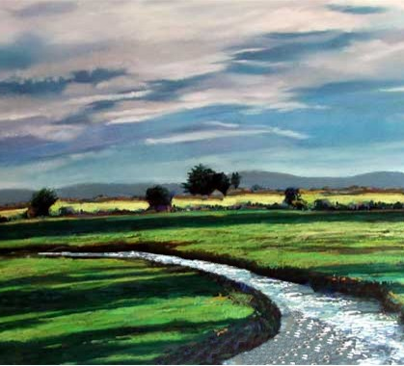
Layout of Program Manual
What you need just when you need it!
Keeping you in the Kairos Riverbanks!

